Slide 1
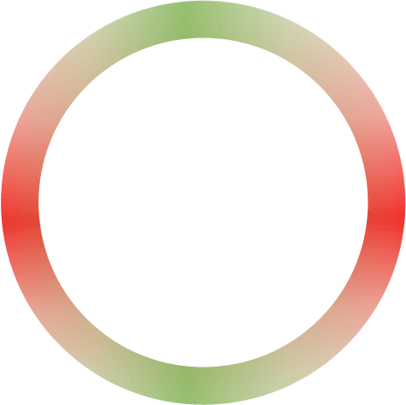






Layer Transition Diagram - Q
$${Secondary}_{i}$$
Parent
$${Primary}_{i}$$
$$L_{i}$$
$Q_{i}$ Emergent axis / new degree of freedom
$$S_{i+1}$$
Child
$$P_{i+1}$$
$$L_{i+1}$$

Slide 2

Layer Transition Diagram – Q - Tilt
ϕ
θ

Slide 3








$$0$$
Free Space
$$w= \frac{R_{s}}{r}$$
$$Q$$
$$Meridian$$
Hypersphere Meridian
$$1$$
$$0$$
$$W$$
$$1$$
Event Horizon

